Slide 1
Smart Assignment Management System
Revolutionizing assignment workflows in educational institutions.
Problem Statement: ED-TECH #2
Hackathon: Xypher 2025
Team Name:
TEAM CODEX
Team Captain: Ansh Agarwal
Registration No.- 2502052364
Email Id- ansh.2502052364@muj.manipal.edu

Slide 2
Addressing Core Inefficiencies
The current assignment management landscape is riddled with inefficiencies, impacting all stakeholders in the education ecosystem.
For Teachers
For Students
For Institutions
Manual grading consumes valuable time, leading to bottlenecks and delayed feedback for students.
Unclear submission processes and a lack of visibility into their performance create frustration.
Absence of standardized evaluation methods hinders transparency.
Their ability to track academic progress is limited.
Lack of centralized reporting limits effective oversight of academic performance.
The process is often repetitive and lacks analytical insights.
The core issue lies in outdated systems that hinder efficiency and transparency, failing to support a dynamic learning environment.

Slide 3
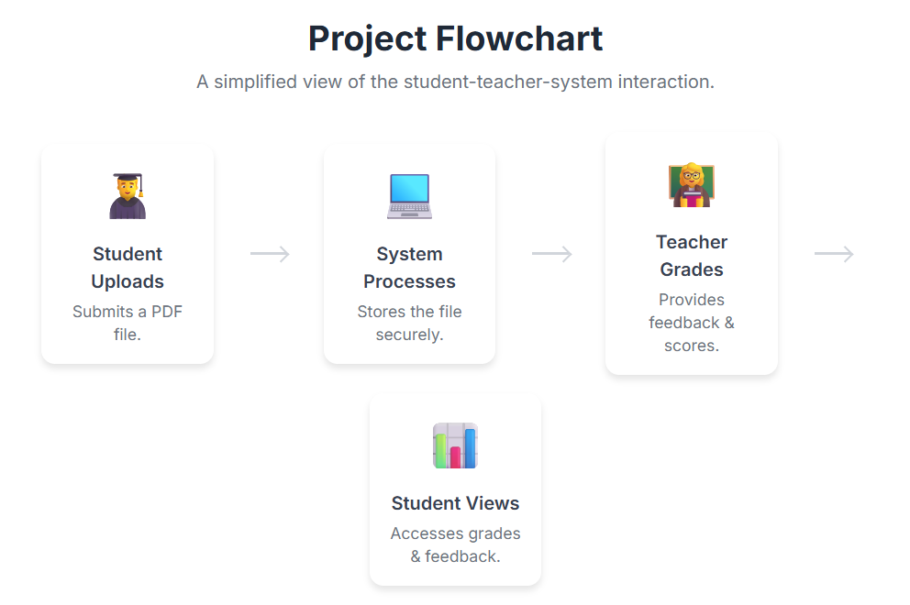
Feasibility: Our Hackathon MVP
Our Minimum Viable Product focuses on delivering essential functionalities to address the most pressing issues.
MVP Scope & Features
Technical Cornerstones
01
Secure Authentication: Protecting user data.
Student PDF Submission
Reliable File Storage: Ensuring assignment integrity.
Seamless upload and management of assignment files.
Role-Based Dashboards: Tailored user experiences.
02
Key Challenges
Teacher Grading Dashboard
Data Security: Paramount for sensitive information.
Intuitive interface for question-wise
marking.
03
Scalability: Adapting to large user
bases.
Basic Performance Analytics
Cloud Hosting Costs: Optimizing resource usage.
Initial insights for tracking student
progress.

Slide 4
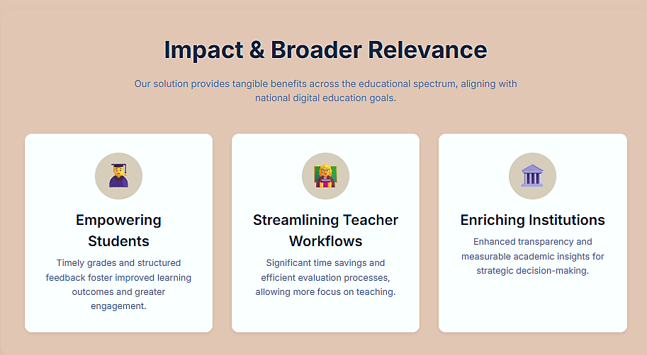



Impact & Broader Relevance
Our solution provides tangible benefits across the educational spectrum, aligning with national digital education goals.
Empowering Students
Timely grades and structured feedback foster improved learning outcomes and greater engagement.
Streamlining Teacher Workflows
Significant time savings and efficient evaluation processes, allowing more focus on teaching.
Enriching Institutions
Enhanced transparency and measurable academic insights for strategic decision-making.
This project directly supports India’s Digital Education initiatives and the NEP 2020 emphasis on tech-driven learning transformation.

Slide 5
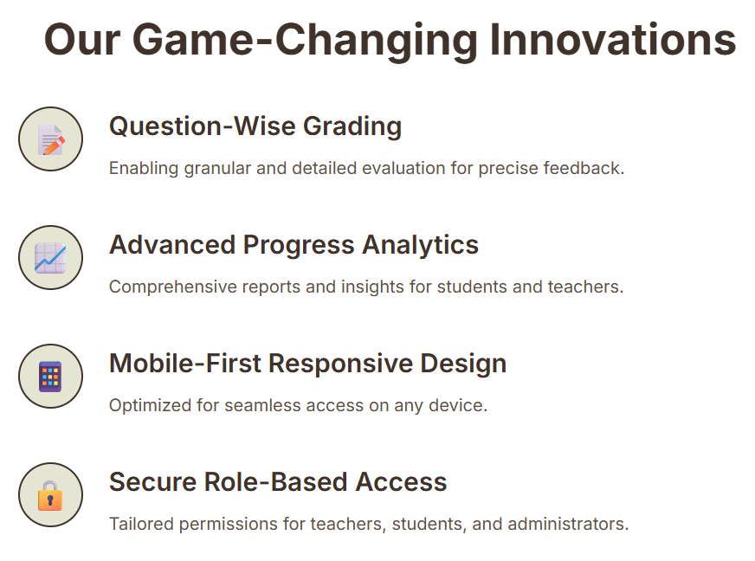

Our Distinct Innovation Edge
While existing tools offer basic functionalities, our platform introduces critical innovations for a superior user experience.
Limitations of Existing Tools
Our Game-Changing Innovations
Generic Features: Not tailored for specific needs.
Question-Wise Grading
Enabling granular and detailed evaluation for precise feedback.
Minimal Analytics: Lacking deep performance insights.
Advanced Progress Analytics
Poor Mobile Usability: Hindering access on the go.
Comprehensive reports and insights for students and teachers.
Limited Customization: One-size-fits-all approach.
Mobile-First Responsive Design
(e.g., Google Classroom, Moodle,
Blackboard)
Optimized for seamless access on any device.
Secure Role-Based Access
Tailored permissions for teachers, students, and administrators.

Slide 6
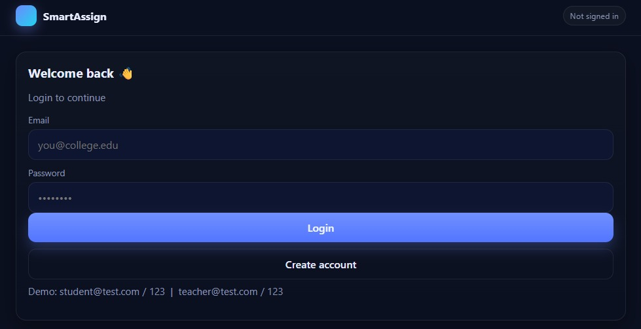
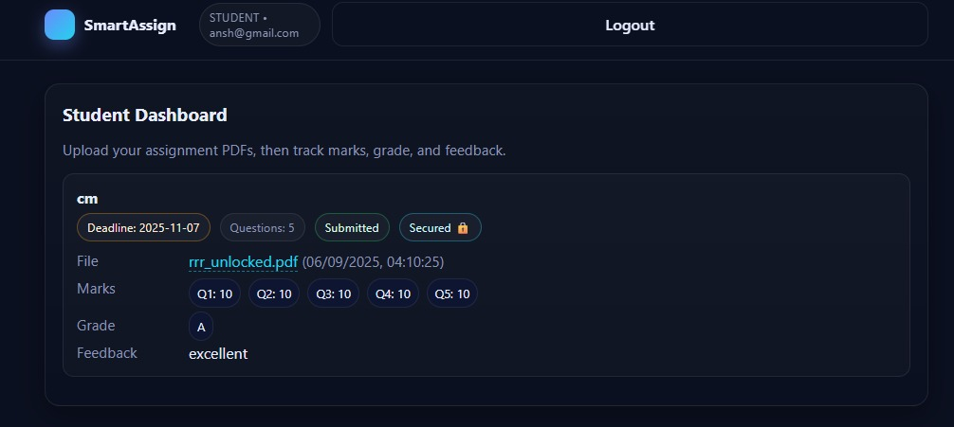
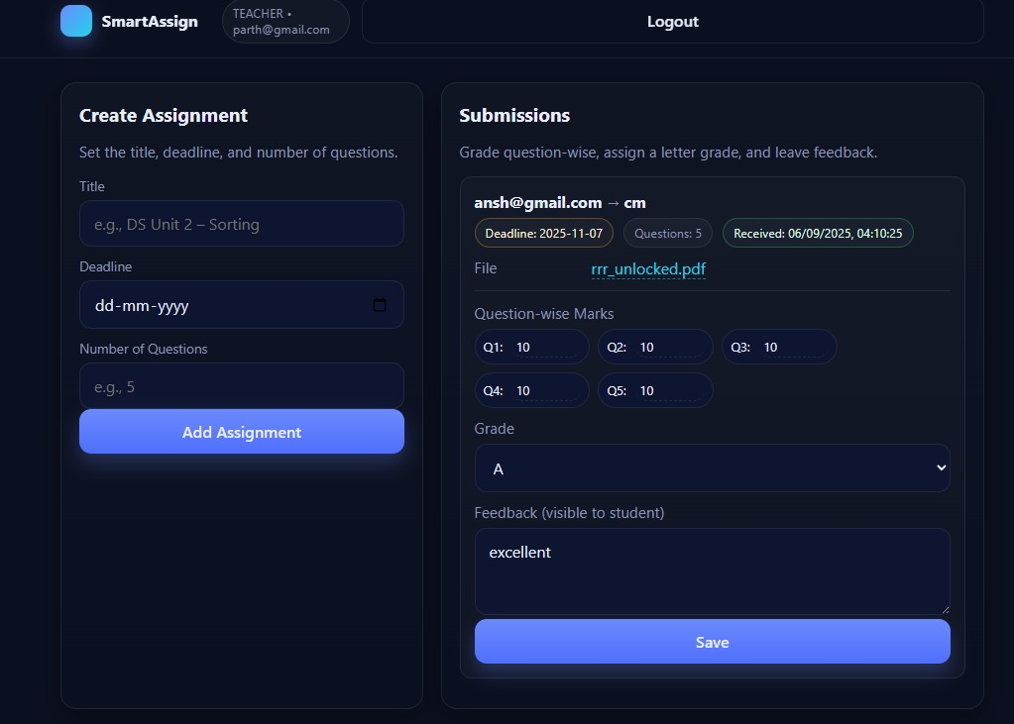
Our Proposed Solution Architecture
A structured, transparent, and scalable ecosystem designed for modern educational demands.
1
2
Student Dashboard
Teacher Dashboard
Easy assignment uploads
Efficient question-wise grading
Real-time submission tracking
Streamlined assignment management
Access to grades & teacher feedback
Automated report generation
Class performance analytics
3
Core System Features
Robust secure authentication
Scalable cloud storage infrastructure
Cross-platform mobile compatibility
Outcome: A transparent and efficient assignment management ecosystem that reduces administrative burden and enhances the learning experience.

Slide 7
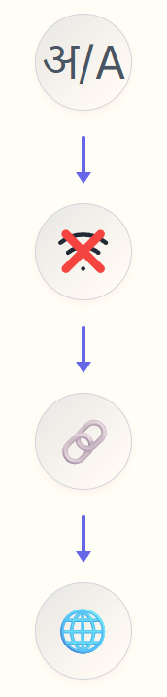

Future Vision & Conclusion
Our Smart Assignment Management System is poised for significant expansion, ready to adapt to diverse educational needs.
Multi-Language Support
Expanding accessibility for diverse user bases.
Offline-First Submissions
Ensuring functionality in low-connectivity regions.
ERP/LMS Integration
Seamless compatibility with existing institutional systems.
Nationwide Scalability
Extending reach to schools, colleges, and universities across India.
The Smart Assignment Management System is designed to reduce teacher workload, enhance transparency, and empower students with clear academic progress tracking. It’s a practical, efficient, and scalable solution for modern education. 🚀

Slide 8
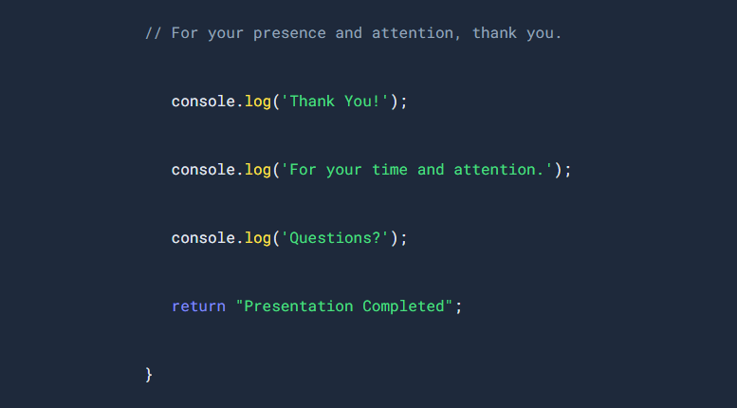
THANK YOU
Team Member: Ansh Agarwal
Registration No.- 2502052364
Team Member: Suryansh Yadav
Registration N0:: 2502052397
Team Member: Parth Mathur
Registration No: 2502052209

